Slide 1
Introduction
Vimala Govindan (Bosch, Sr. Cloud DevOps Engineer)
About Me…!
About Work Experience
20+ Years in IT Industry
Various Roles: Software Developer, Project Manager, DevOps Engineer

Slide 2
Agenda
Overview of Cloud Technology
Bosch IoT Cloud
Testing in Cloud
Monitoring in Cloud - Smoke Test Framework

Slide 3
Cloud Technology
What is the “cloud” ?
Definitions 25+
Delivery of hosted services over the internet
Enables access to shared pools of system resources and services
Network of remote servers hosted on the Internet to store, process and manage data
Storing and retrieving data (images, files etc.) and programs over the Internet instead of using one’s own computer ( iCloud, Dropbox)
A distinct IT environment that is designed for the purpose of remotely provisioning scalable and measurable IT resources

Slide 4

Cloud Technology
Cloud Computing Explained
Video Link: https://www.youtube.com/watch?v=QJncFirhjPg

Slide 5
Cloud Technology
Evolution of Cloud
Year 2000 – 2005 : DOT-COM bubble forces companies to find effective ways to use IT resources
Year 2006 : Amazon enters cloud market (S3 , AWS)
Year 2007 – 2008 : It was not clear if the the cloud technology is the way to go or not ( Google glass)
Year 2008 – 2009 : There was movement toward Private cloud than Public
Year 2009 – 2011 : The movement shifted toward public cloud
Year 2011 is called “the year of cloud” with hybrid cloud movement

Slide 6
Cloud Technology
Everyday use of Cloud by Individuals
Apple iCloud
Google Gmail
Dropbox
Google Drive
Microsoft OneDrive

Slide 7
Cloud Technology
Everyday use of Cloud by Corporations
Netflix uses AWS
Pinterest uses AWS
Polycom uses Azure
HP uses Azure
Seattle Seahawks

Slide 8
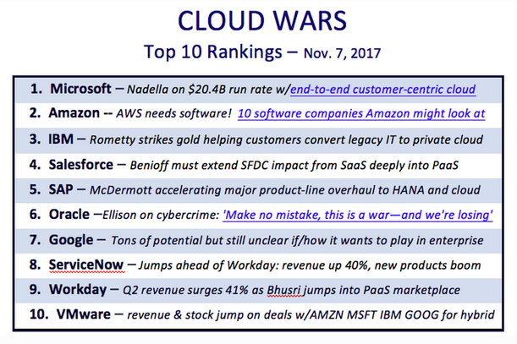
Cloud Technology
Major Players in Cloud
Reference: https://www.forbes.com/sites/bobevans1/2017/11/07/the-top-5-cloud-computing-vendors-1-microsoft-2-amazon-3-ibm-4-salesforce-5-sap/#cb5cc426f2eb

Slide 9
Cloud Technology
Benefits of Cloud
Scalability ( elasticity)
Cost efficient
Network access
Measured consumption ( pay per use )
Self-service
Shared resource pooling
Ability to improve/increase time to market
Quickly validate business model and make Go or no-go decision without spending too much on fixed assets or people

Slide 10
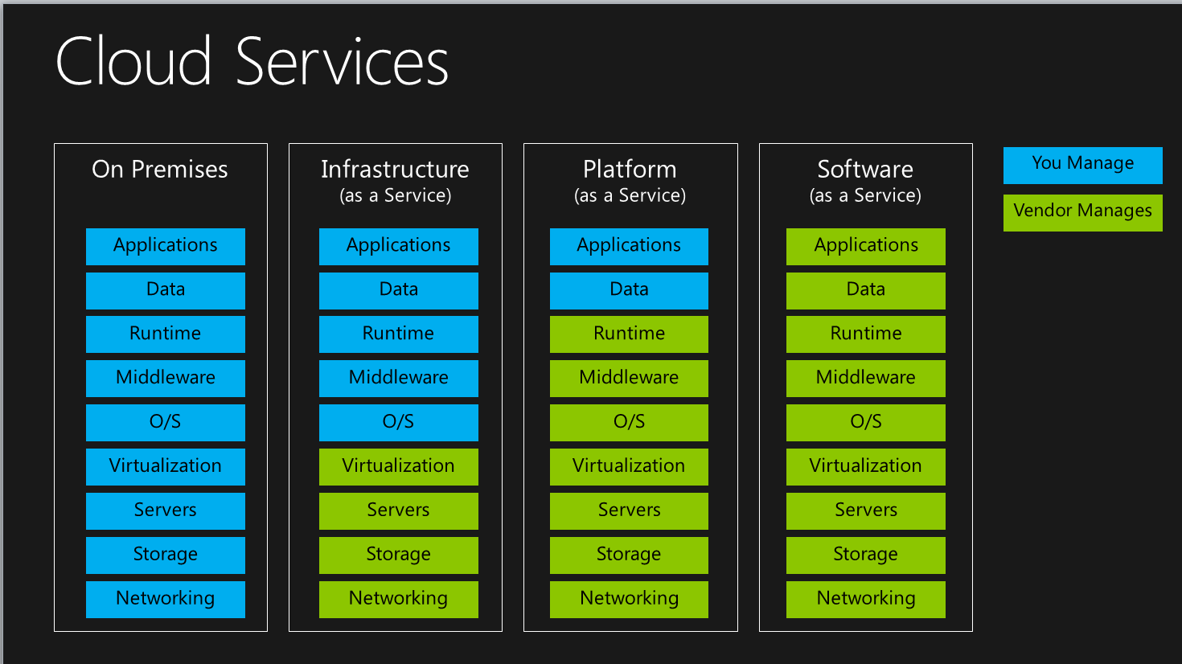
Cloud Technology
Deep Dive
Image Reference - https://fundamentalcloud.wordpress.com/2015/08/21/how-would-you-explain-iaas-paas-saas-to-your-mom

Slide 11

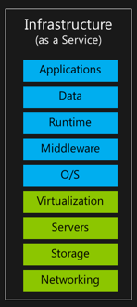
Cloud Technology
Infrastructure as a Service(IaaS)
Amazon AWS EC2
Azure Virtual Machines
VMware vSphere ( ESXi)
OpenStack ( can work with many hypervisors)
Image Reference - https://fundamentalcloud.wordpress.com/2015/08/21/how-would-you-explain-iaas-paas-saas-to-your-mom

Slide 12
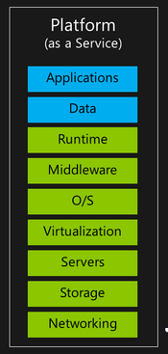
Cloud Technology
Platform as a Service(PaaS)
Amazon AWS Elastic Beanstalk
Azure Cloud Service
Cloud Foundry
Pivotal Cloud Foundry
RedHat’s OpenShift
Image Reference - https://fundamentalcloud.wordpress.com/2015/08/21/how-would-you-explain-iaas-paas-saas-to-your-mom

Slide 13
Cloud Technology
Keywords
IaaS ( Infrastructure as a Service)
PaaS ( Platform as a Service)
SaaS ( Software as a Service)
Elasticity
Virtualization / Virtual Machines
Private, Public and Hybrid cloud
12 Factor app / Cloud Native
Tenant / Multi Tenant

Slide 14
Cloud Technology
Quiz
Name couple of top cloud service providers ?
The 3 layer that make up cloud platform?
Name some of the key benefits of cloud?
What does IaaS, PaaS and SaaS stand for ?

Slide 15
Cloud Technology
Bosch IoT Cloud

Slide 16
Cloud Technology
About Bosch
Bosch is a Germany company headquartered in Gerlingen, near Stuttgart, Germany
About 400K employees
Focus Areas: Mobility Solutions, Consumer Goods, Industrial Technology and Energy and Building Technology

Slide 17
Cloud Technology
Bosch Launches Its Own IoT Cloud
Video https://youtu.be/mm85yY70uCk

Slide 18
Cloud Technology
Bosch Enters into Cloud Business
Bosch manufactures many types of devices and appliances: medical devices, power tools, dish washer and cooktops and many type of sensors
Bosch in Sensors: motion, environmental and optical
Motion Sensors example – eCompass high precision sensors for compass applications in smart phones and navigation system
Environmental – to measure gas, pressure, humidity and temperature used in IoT and Wearable application
Optical – Microscanner ( like pico-projector) used in robotics and IoT applications

Slide 19
Cloud Technology
Bosch Enters into Cloud Business
Optical – Microscanner ( like pico-projector) used in robotics and IoT applications
Video https://youtu.be/_8zq1JoI_eY

Slide 20
Cloud Technology
Bosch Cloud Implementation
In 4 countries
5 instances/setup
Global Architecture

Slide 21
Cloud Technology
Bosch IoT Cloud
IoT (Internet of Things) Cloud:
Provides services to interface with various sensors ( connected devices)
Can handle very high volumes of data generated by devices, sensors, websites and applications
Initiate actions for real-time responses

Slide 22
Cloud Technology
Products used by Bosch
Image Reference - https://fundamentalcloud.wordpress.com/2015/08/21/how-would-you-explain-iaas-paas-saas-to-your-mom

Slide 23
Cloud Technology
Infrastructure as a Service (IaaS)
VMware vSphere Product Suite
VMware vRealize Product Suite
Image Reference - https://fundamentalcloud.wordpress.com/2015/08/21/how-would-you-explain-iaas-paas-saas-to-your-mom

Slide 24
Cloud Technology
Platform as a Service (PaaS)
Pivotal Cloud Service
Image Reference - https://fundamentalcloud.wordpress.com/2015/08/21/how-would-you-explain-iaas-paas-saas-to-your-mom

Slide 25
Cloud Technology
Bosch IoT Suite
Using the Bosch IoT Suite services, developers can quickly build, implement, and operate cloud-based and highly scalable IoT applications. The Bosch IoT Suite provides core functionality for the most common IoT scenarios:
reliably managing devices, machines, and gateways
providing secure access management
executing software rollout processes
connecting third-party systems and services
and analyzing data

Slide 26
Cloud Technology
Bosch IoT Suite
Bosch IoT Analytics
Bosch IoT Gateway Software
Bosch IoT Hub
Bosch IoT Permissions
Bosch IoT Remote manager
Bosch IoT Rollouts
Bosch IoT Things

Slide 27
Cloud Technology
Bosch IoT Suite
Bosch IoT Gateway Software(Indirect Connection)
Supports indirect connection of devices via gateways (I.e., for data privacy reasons and many other use cases)
Bosch IoT Hub (Connectivity)
Easy and secure device connectivity for the IoT
Bosch IoT Remote manager
Responsible for device configuration, monitoring, and remote maintenance(both directly connected and through gateway)
Bosch IoT Permissions (user and permission management)
Authentication and Authorization management for IoT applications

Slide 28
Cloud Technology
Bosch IoT Suite
Bosch IoT Analytics ( Data Analytics)
Provides a set of services that greatly simplifies the analysis and use of field/device data.
Bosch IoT Rollouts
Provides functionality to reliably provision and update software on IoT gateways and devices
Bosch IoT Things(Digital Twin)
Enables the creation of an abstract representation of a real-world asset/device (any “thing”) in the cloud.

Slide 29
Cloud Technology
Use Cases
Connected Vehicles: HUK-COBURG smart driver program
Smart Home : The Bosch Smart Home System
Smart Agriculture: Harvest optimization (asparagus, oyster strawberry farms)
Learn more about oyster farming http://bit.ly/2Epor7f

Slide 30

Cloud Technology
Bosch IoT Cloud – Use Case ( Greenhouse Farming)
Smart solution to optimize greenhouse farming
Video - https://youtu.be/15AoWrCJOSo

Slide 31
Cloud Technology
Testing in Cloud
QA setup
T1 - Infrastructure hardware and environment update and configuration testing
T2 – PaaS/Runtime Development and Testing
T3 – Runtime and platform service integration and validation
T4 – Platform Patching ( keep the system close to prod)

Slide 32
Cloud Technology
Quiz
What does the IoT stands for ?
What is Bosch cloud system called?
What product does Bosch use to support their IaaS layer?
What product does Bosch use to support their PaaS layer?
What does Bosch do to do their testing in Cloud?
Name one use case that we discussed that uses Bosch IoT cloud?

Slide 33
Cloud Technology
Smoke Test Framework

Slide 34
Cloud Technology
Smoke Test Framework
The Smoke Test Framework is a monitoring concept for checking and reporting the availability of a service and/or a service plan

Slide 35
Cloud Technology
Smoke Test Framework
The primary goal of a monitoring smoke test is to answer the following questions:
Are existing services up and running from a customer perspective?
Can the customer request a new service and/or remove existing ones?
Basically fulfills the requirement for SLA and SLR

Slide 36
Cloud Technology
SLA and SLR concepts
SLA ( Service Level Availability)
A SLA is a formal negotiated agreement between the servicer provider and the customer. It can cover many aspects of the service like service availability, performance, customer service, billing etc.
SLR ( Service Level Reporting)
SLR is a service running on PCF ERT which determines the downtime events and send it to ‘Usage Server’

Slide 37
Cloud Technology
Main Components
vRealize Orchestrator(VRO)
vRealize Operations Manager(vROPs)
VRealize Log Insight(vRLI)
Pivotal Cloud Foundry(PCF)

Slide 38
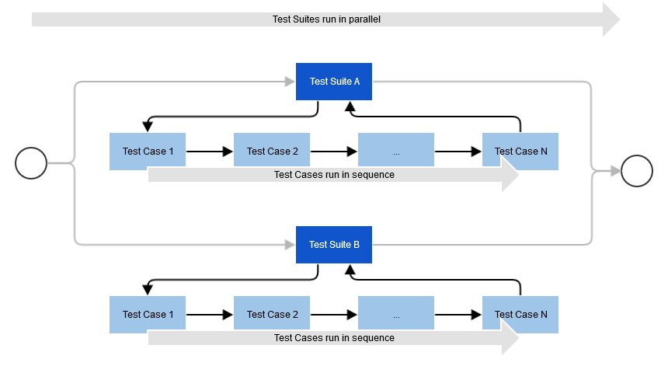
Cloud Technology
Test Suite and Test Case

Slide 39
Cloud Technology
Service Availability
It covers two aspects of availability:
Static Test: Availability of a running service instance:
Periodically call the deployed test app in order to perform few basic functionalities
Dynamic Test: Availability of a service life cycle (manageability)
Order a new instance of a service from the marketplace and do the testing

Slide 40
Cloud Technology
References and Citations
Cloud Wars
Cloud Wars
Cloud Fundamentals

Slide 41
Cloud Technology
Videos Links
Cloud Computing Explained - https://www.youtube.com/watch?v=QJncFirhjPg
Bosch Sensor(Optical Projector) - https://youtu.be/_8zq1JoI_eY
Bosch IoT Cloud Launch - https://youtu.be/mm85yY70uCk
Use Case – Greenhouse Farming - https://youtu.be/15AoWrCJOSo

